Slide 1
Text Analytics methods

Slide 2
Tokenization
Sentence Tokenization
Word Tokenization
Frequency Distribution
Stopwords
Removing stopwords

Slide 3
Lexicon Normalization
Lexicon normalization considers another type of noise in the text. For example, connection, connected, connecting word reduce to a common word "connect". It reduces derivationally related forms of a word to a common root word.
Stemming
Lemmetization

Slide 4
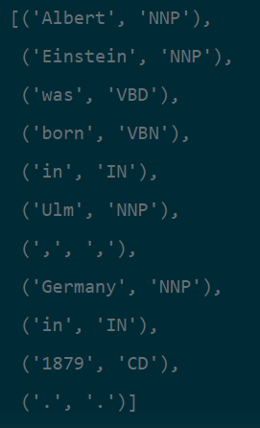
POS tagging

Slide 5
Sentiment Analysis

Slide 6
Lexicon based analysis
Machine learning based approach

